Slide 1
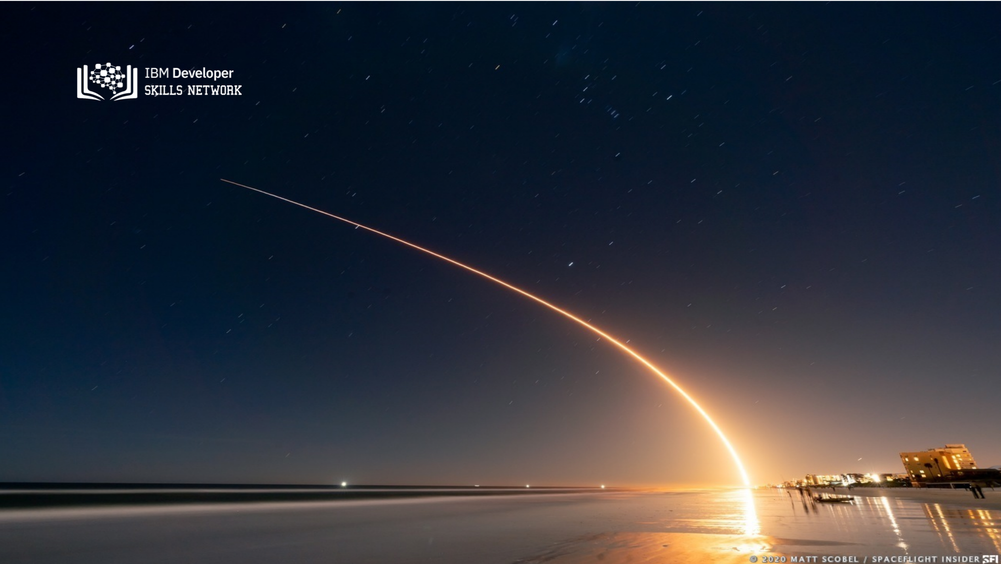
SpaceX Falcon 9 First Stage landing prediction
Fan Zhao Ting
2022.03.23

Slide 2

Outline
Executive Summary
Introduction
Methodology
Results
Conclusion
Appendix

Slide 3
Executive Summary
In an intensely competitive business landscape, SpaceX has emerged as a pioneer in the aerospace industry through its groundbreaking approach of reusing the initial stage launcher/booster of the Falcon 9 rocket, resulting in substantial cost savings amounting to millions of dollars.
To maintain its competitive edge in cost-efficiency compared to traditional launchers, the success of Falcon 9 missions hinges on specific factors, including:
Orbit
Payload mass
Booster version
launch sites
The research conducted for this report led to the development of a supervised machine learning classification model. This model, with an accuracy rate nearing 94%, successfully predicts the outcome of booster recovery based on these critical mission features.

Slide 4
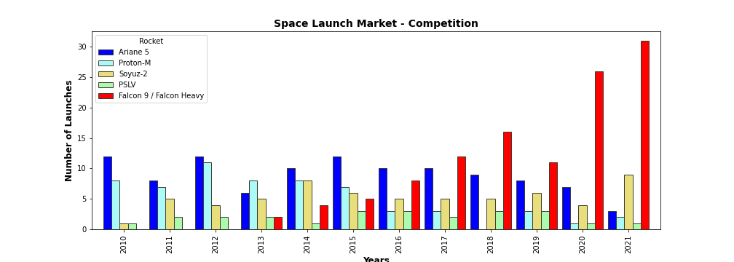
Introduction
SpaceX advertises Falcon 9 rocket launches on its website, with a cost of 62 million dollars; other providers cost upward of 165 million dollars each, much of the savings is because SpaceX can reuse the first stage. Therefore if we can determine if the first stage will land, we can determine the cost of a launch. This information can be used if an alternate company wants to bid against SpaceX for a rocket launch.
Problems you want to find answers
What factors determine if the rocket will land successfully?
The interaction amongst various features that determine the success rate of a successful landing.
What operating conditions needs to be in place to ensure a successful landing program.

Slide 5

Section 1

Slide 6
Methodology
Data collection from open Data (SpaceX API and web scraping from Wikipedia)
Data wrangling(One-hot encoding was applied to categorical features)
Exploratory data analysis (EDA) using visualization and SQL
Perform interactive visual analytics using Folium and Tableau
Classification Models development and validations. Selection of best predictive model.

Slide 7
Data Collection
SpaceX REST API
Web scraping Wikipedia
Requested and parsed SpaceX launch data
Get URL response
Data was collected from:
-open source SpaceX REST API
-webscraping Falcon9 launch data in Wikipedia
Restricted dataframe to Falcon 9 launches
Extract Table data with Beautiful soup
Replaced missing payload value with mean value
Clean
Saved data into csv file
data_set_part1.csv
Saved data into csv file
data_set_part2.csv

Slide 8
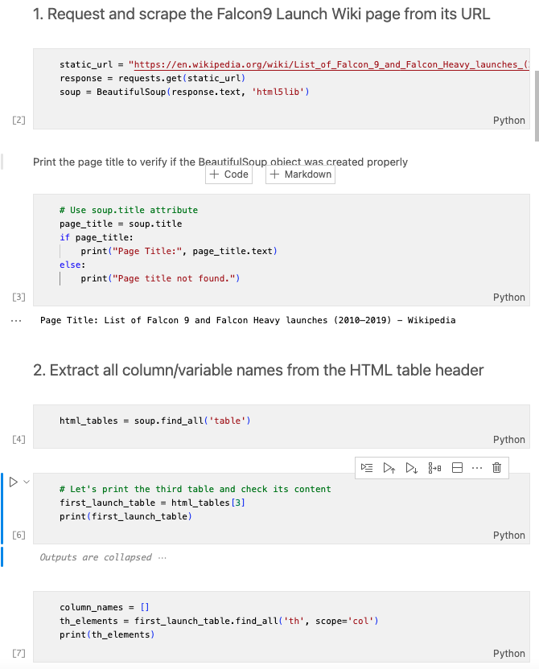
Data Collection - Web Scraping
Acquired historical launch data from Wikipedia page 'List of Falcon 9 and Falcon Heavy Launches' with BeautifulSoup
We parsed the table and converted it into a pandas dataframe.
The link to the notebook is https://github.com/brianfn/private-space-launch
-company-analysis/blob/
main/falcon_webscraping.ipynb

Slide 9
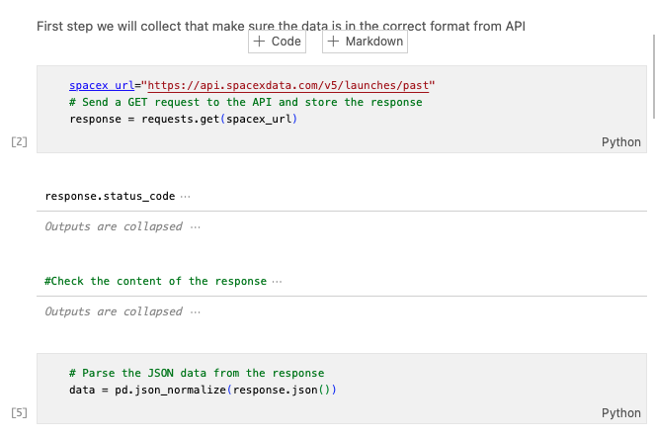
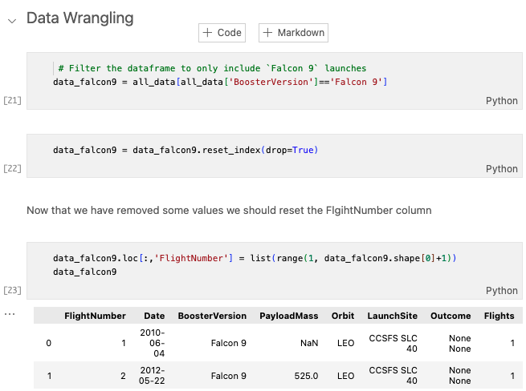
Data Collection – SpaceX API
Requested rocket launch data from SpaceX API
url=https://api.spacexdata.com/v4/launches/past
Requested and parsed
SpaceX data with GET request
data wrangling and formatting
The link to the notebook is https://github.com/brianfn/private-space-launch-company-analysis/blob/main/falcon_api.ipynb

Slide 10

Data Wrangling
We performed exploratory data analysis and determined the training labels.
We calculated the number of launches at each site, and the number and occurrence of each orbits
We created landing outcome label from outcome column and exported the results to csv.
The link to the notebook is https://github.com/brianfn/private-space-launch-company-analysis/blob/main/falcon_datawrangling.ipynb

Slide 11

EDA with Data Visualization
We explored the data by visualizing the relationship between
flight number and payload
payload and launch site
success rate of each orbit type
flight number and orbit type
launch success yearly trend.
The link to the notebook is https://github.com/brianfn/private-space-launch-company-analysis/blob/main/falcon_eda_dataviz.ipynb

Slide 12
EDA with SQL
establishing a connection to an SQLite database and load dataset inside
We applied EDA with SQL to get insight from the data. We wrote queries to find out for instance:
The names of unique launch sites in the space mission.
The total payload mass carried by boosters launched by NASA (CRS)
The average payload mass carried by booster version F9 v1.1
The total number of successful and failure mission outcomes
The failed landing outcomes in drone ship, their booster version and launch site names.
The link to the notebook is https://github.com/chuksoo/IBM-Data-Science-Capstone-SpaceX/blob/main/EDA%20with%20SQL.ipynb

Slide 13
Build an Interactive Map with Folium
Folium Interactive Map was used for visualizing and analyzing SpaceX Launch Sites
Utilize objects in Folium library like markers, circles to:
Identified all SpaceX launch sites on a map: Florida, California.
Included longitude and latitude info.
Identified successful/failed launches for each site on map.
We calculated the distances between a launch site to its proximities. We answered some question for instance:
Are launch sites near railways, highways and coastlines.
Do launch sites keep certain distance away from cities.

Slide 14
Build a Dashboard with Tableau
Interactive dashboard with Plotly including:
Show the total launches by a certain sites
the landing success rate troughout the year
Range slider for selecting range of payload mass (kg).
Analyzing SpaceX launch records features:
site with largest successful launches.
site with highest launch success rate
F9 Booster version (v1.0, v1.1, FT, B4, B5, etc.) with highest launch success rate.
The link to the notebook is https://github.com/chuksoo/IBM-Data-Science-Capstone-SpaceX/blob/main/app.py

Slide 15
Predictive Analysis (Classification)
Load the data using numpy and pandas, transformed the data, split our data into training and testing.
Built Logistic Regression, SVM, DT, KNN models and tune different hyperparameters using GridSearchCV.
We used accuracy and Confusion matrix as the metric for our model, improved the model using feature engineering and algorithm tuning.
Select bet model
The link to the notebook is https://github.com/brianfn/private-space-launch-company-analysis/blob/main/falcon_ML_Predict.ipynb

Slide 16
Results
Exploratory data analysis results
Interactive analytics demo in screenshots
Predictive analysis results

Slide 17

Section 2

Slide 18
Flight Number vs. Launch Site
Show a scatter plot of Flight Number vs. Launch Site
Show the screenshot of the scatter plot with explanations

Slide 19
Payload vs. Launch Site
Show a scatter plot of Payload vs. Launch Site
Show the screenshot of the scatter plot with explanations

Slide 20
Success Rate vs. Orbit Type
Show a bar chart for the success rate of each orbit type
Show the screenshot of the scatter plot with explanations

Slide 21
Flight Number vs. Orbit Type
Show a scatter point of Flight number vs. Orbit type
Show the screenshot of the scatter plot with explanations

Slide 22
Payload vs. Orbit Type
Show a scatter point of payload vs. orbit type
Show the screenshot of the scatter plot with explanations

Slide 23
Launch Success Yearly Trend
Show a line chart of yearly average success rate
Show the screenshot of the scatter plot with explanations

Slide 24
All Launch Site Names
Find the names of the unique launch sites
Present your query result with a short explanation here

Slide 25
Launch Site Names Begin with 'CCA'
Find 5 records where launch sites begin with `CCA`
Present your query result with a short explanation here

Slide 26
Total Payload Mass
Calculate the total payload carried by boosters from NASA
Present your query result with a short explanation here

Slide 27
Average Payload Mass by F9 v1.1
Calculate the average payload mass carried by booster version F9 v1.1
Present your query result with a short explanation here

Slide 28
First Successful Ground Landing Date
Find the dates of the first successful landing outcome on ground pad
Present your query result with a short explanation here

Slide 29
Successful Drone Ship Landing with Payload between 4000 and 6000
List the names of boosters which have successfully landed on drone ship and had payload mass greater than 4000 but less than 6000
Present your query result with a short explanation here

Slide 30
Total Number of Successful and Failure Mission Outcomes
Calculate the total number of successful and failure mission outcomes
Present your query result with a short explanation here

Slide 31
Boosters Carried Maximum Payload
List the names of the booster which have carried the maximum payload mass
Present your query result with a short explanation here

Slide 32
2015 Launch Records
List the failed landing_outcomes in drone ship, their booster versions, and launch site names for in year 2015
Present your query result with a short explanation here

Slide 33
Rank Landing Outcomes Between 2010-06-04 and 2017-03-20
Rank the count of landing outcomes (such as Failure (drone ship) or Success (ground pad)) between the date 2010-06-04 and 2017-03-20, in descending order
Present your query result with a short explanation here

Slide 34

Section 3

Slide 35
<Folium Map Screenshot 1>
Replace <Folium map screenshot 1> title with an appropriate title
Explore the generated folium map and make a proper screenshot to include all launch sites’ location markers on a global map
Explain the important elements and findings on the screenshot

Slide 36
<Folium Map Screenshot 2>
Replace <Folium map screenshot 2> title with an appropriate title
Explore the folium map and make a proper screenshot to show the color-labeled launch outcomes on the map
Explain the important elements and findings on the screenshot

Slide 37
<Folium Map Screenshot 3>
Replace <Folium map screenshot 3> title with an appropriate title
Explore the generated folium map and show the screenshot of a selected launch site to its proximities such as railway, highway, coastline, with distance calculated and displayed
Explain the important elements and findings on the screenshot

Slide 38

Section 4

Slide 39
<Dashboard Screenshot 1>
Replace <Dashboard screenshot 1> title with an appropriate title
Show the screenshot of launch success count for all sites, in a piechart
Explain the important elements and findings on the screenshot

Slide 40
<Dashboard Screenshot 2>
Replace <Dashboard screenshot 2> title with an appropriate title
Show the screenshot of the piechart for the launch site with highest launch success ratio
Explain the important elements and findings on the screenshot

Slide 41
<Dashboard Screenshot 3>
Replace <Dashboard screenshot 3> title with an appropriate title
Show screenshots of Payload vs. Launch Outcome scatter plot for all sites, with different payload selected in the range slider
Explain the important elements and findings on the screenshot, such as which payload range or booster version have the largest success rate, etc.

Slide 42

Section 5

Slide 43
Classification Accuracy
Visualize the built model accuracy for all built classification models, in a bar chart
Find which model has the highest classification accuracy

Slide 44
Confusion Matrix
Show the confusion matrix of the best performing model with an explanation

Slide 45
Conclusions
Point 1
Point 2
Point 3
Point 4
…

Slide 46
Appendix
Include any relevant assets like Python code snippets, SQL queries, charts, Notebook outputs, or data sets that you may have created during this project

Slide 47


